Slide 1

Demonstration on New Data
Tested our model on staffs from songs released after the PrIMuS dataset was created
Song #1: I Don’t Care - Ed Sheeran & Justin Bieber (2019)
Actual notes: [‘Ab4’, ‘Gb4’, ‘Gb4’, ‘Ab4’, ‘Ab4’, ‘Gb4’, ‘Gb4’, ‘Gb4’, ‘Gb4’, ‘Gb4’, ‘Ab4’, ‘Ab4’, ‘Gb4’, ‘Gb4’, ‘Ab4’, ‘Ab4’, ‘Gb4’, ‘Bb4’ ]
Accuracy: 0%

Slide 2
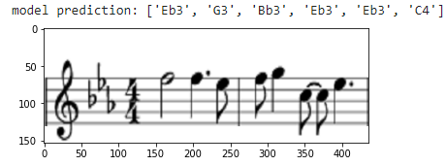
Demonstration on New Data
Song #2: Blinding Lights - The Weeknd (2019)
Actual notes: [‘F5’, ‘F5’, ‘Eb5’, ‘F5’, ‘G5’, ‘C5’, ‘C5’, ‘Eb5’ ]
Accuracy: 0%

Slide 3
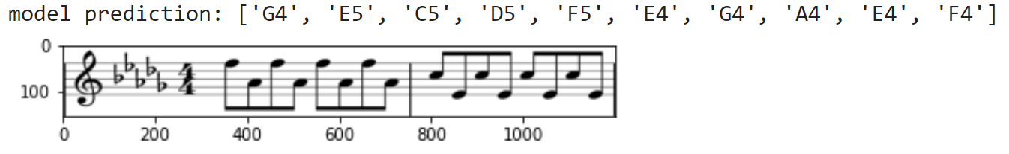
Demonstration on New Data
Song #3: Someone You Loved - Lewis Capaldi (2019)
Actual notes: [‘F5’, ‘Ab4’, ‘F5’, ‘Ab4’, ‘F5’, ‘Ab4’, ‘F5’, ‘Ab4’, ‘C5’, ‘E4’, ‘C5’, ‘E4’, ‘C5’, ‘E4’, ‘C5’, ‘E4’]
Accuracy: 6.25%
Notes:
These were our results. As you can see, the model obtained a 6.25% accuracy on this image.

